Slide 1


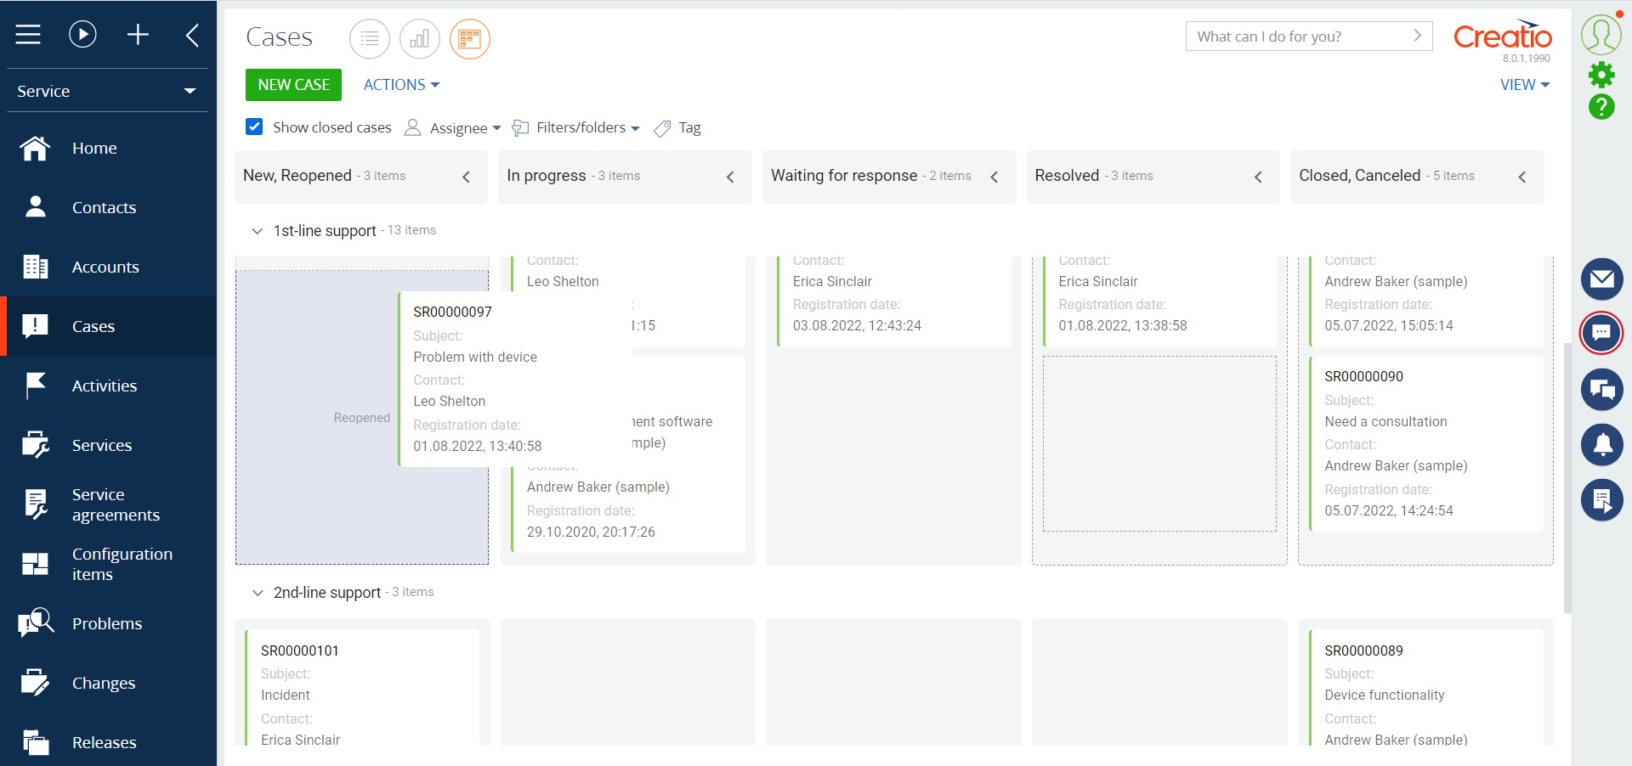
Data views
Turn to the visualization with the help of
Gantt Chart and Kanban Board

Slide 2

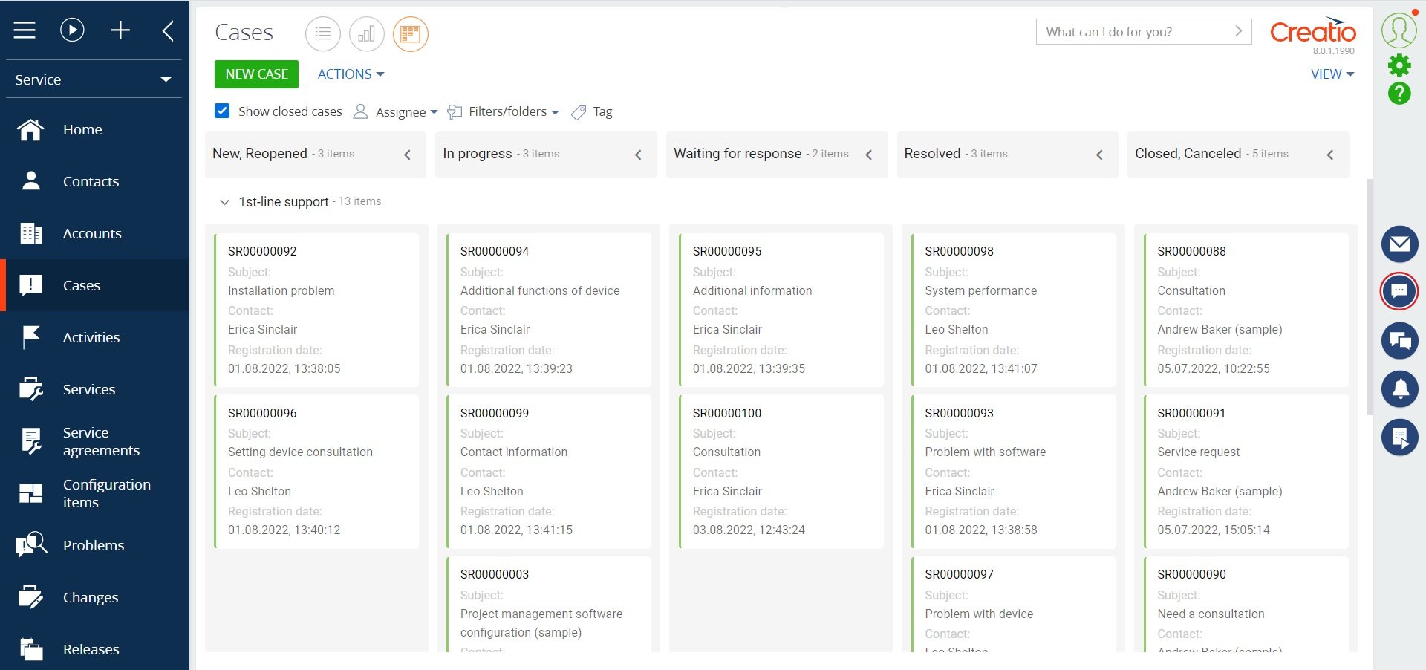
Data views for Creatio
The Data views for Creatio product makes it possible to display records of any system objects in unusual formats. Displaying data in formats different from the register makes it possible to analyze them faster and more conveniently, the data becomes more coherent, without the need to study it in detail.
Currently, there are 2 types of views available: Gantt Chart and Kanban Board.
Notes:
First of all, we normalize the client base and set up categorization and segmentation. The system allows you to use absolutely any information to categorize clients, from the size of the land bank to the number of goods purchased from us.
Also we calculate the potential of each client based on his land bank and grown
crops. Based on this information, we can prioritize the work of the manager and understand which customer have the maximum potential.
Also we maintaining information about competitor’s products to help the manager more carefully prepare for meetings with the client and consider with whom the client compares us.
and of course analytics. The system allows you to build analytics on any data that is in the system in any slices and views. this will allow you to analyze information in the most convenient form in a single system

Slide 3
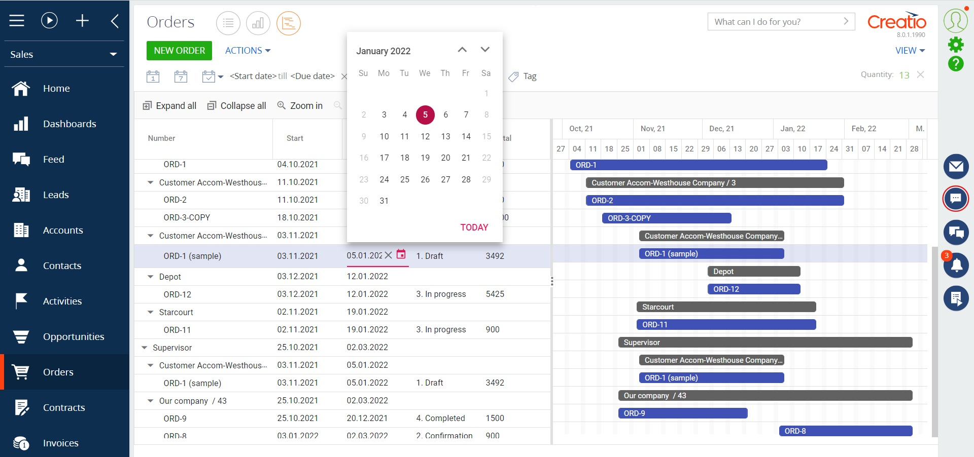
Data views for Creatio
Use cases:
The product can be used by companies of any industry or business area, since it offers universal functionality that does not depend on the business domain and the system objects used.
Notes:
First of all, we normalize the client base and set up categorization and segmentation. The system allows you to use absolutely any information to categorize clients, from the size of the land bank to the number of goods purchased from us.
Also we calculate the potential of each client based on his land bank and grown
crops. Based on this information, we can prioritize the work of the manager and understand which customer have the maximum potential.
Also we maintaining information about competitor’s products to help the manager more carefully prepare for meetings with the client and consider with whom the client compares us.
and of course analytics. The system allows you to build analytics on any data that is in the system in any slices and views. this will allow you to analyze information in the most convenient form in a single system

Slide 4
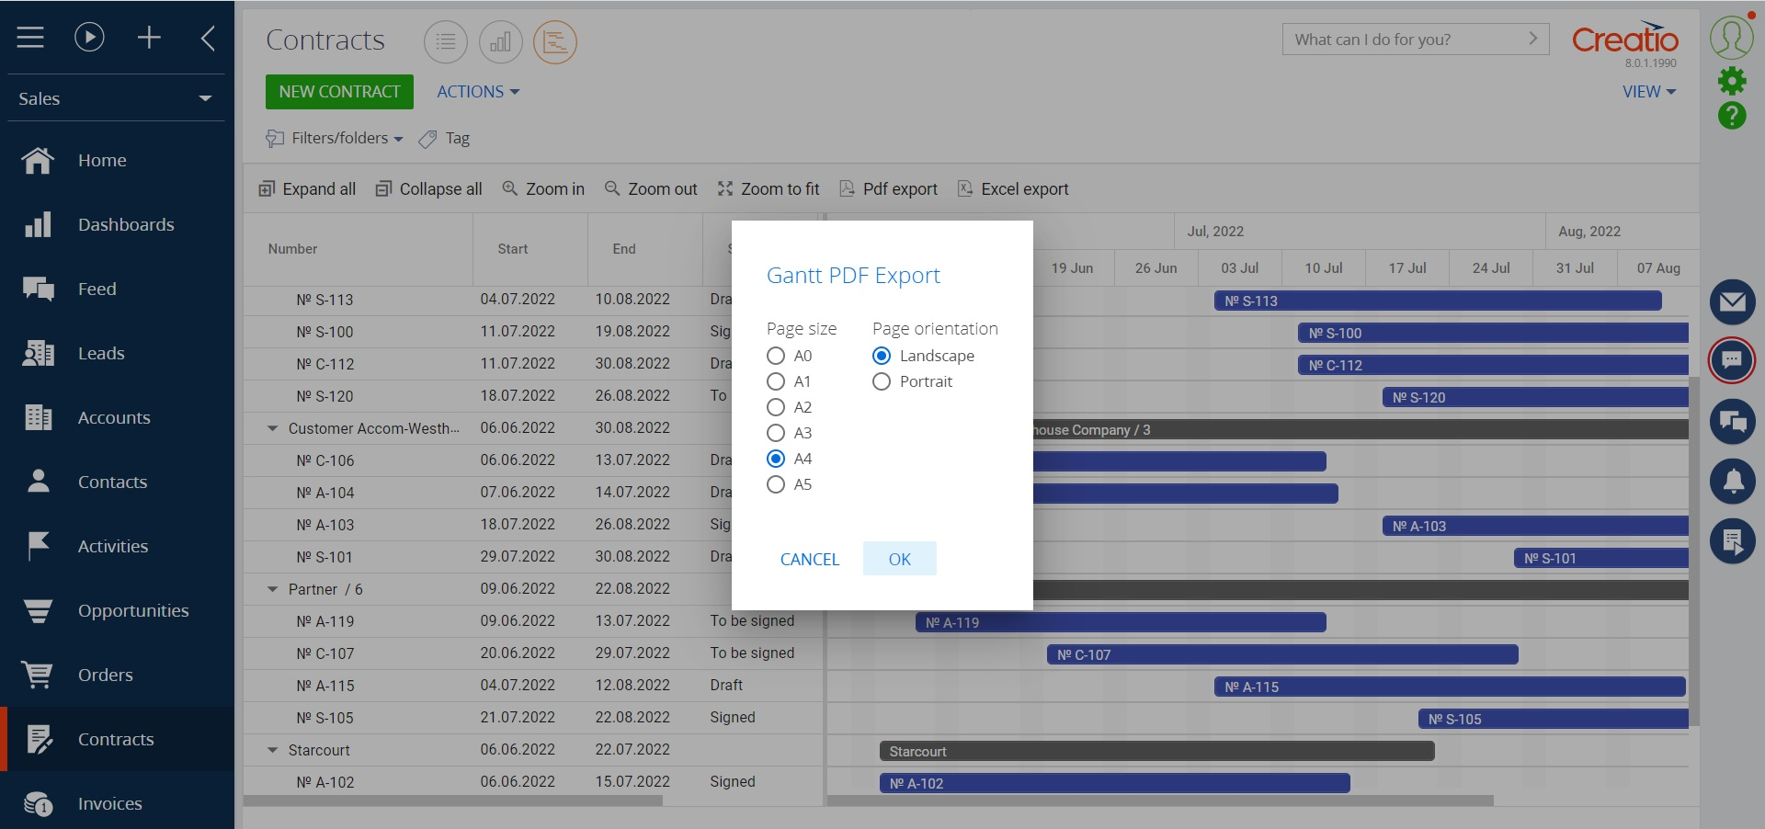
Data views for Creatio
Key features:
Setting up different views in an unlimited number of sections;
Display records in the Gantt chart format;
The ability to follow the dates and the process of working with the record;
Schedule deviation control;
Edit data with dates and duration indicator;
Displaying records in the Kanban board format;
Data analysis with divided by status;
Control of transition conditions between statuses;
Editing post statuses from a user-friendly interface;
Notes:
First of all, we normalize the client base and set up categorization and segmentation. The system allows you to use absolutely any information to categorize clients, from the size of the land bank to the number of goods purchased from us.
Also we calculate the potential of each client based on his land bank and grown
crops. Based on this information, we can prioritize the work of the manager and understand which customer have the maximum potential.
Also we maintaining information about competitor’s products to help the manager more carefully prepare for meetings with the client and consider with whom the client compares us.
and of course analytics. The system allows you to build analytics on any data that is in the system in any slices and views. this will allow you to analyze information in the most convenient form in a single system

Slide 5
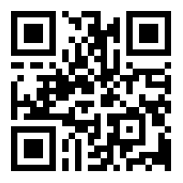
Data views for Creatio
CONTACT US:
salesup-it.com
care@salesup-it.com
Notes:
First of all, we normalize the client base and set up categorization and segmentation. The system allows you to use absolutely any information to categorize clients, from the size of the land bank to the number of goods purchased from us.
Also we calculate the potential of each client based on his land bank and grown
crops. Based on this information, we can prioritize the work of the manager and understand which customer have the maximum potential.
Also we maintaining information about competitor’s products to help the manager more carefully prepare for meetings with the client and consider with whom the client compares us.
and of course analytics. The system allows you to build analytics on any data that is in the system in any slices and views. this will allow you to analyze information in the most convenient form in a single system

