Slide 1


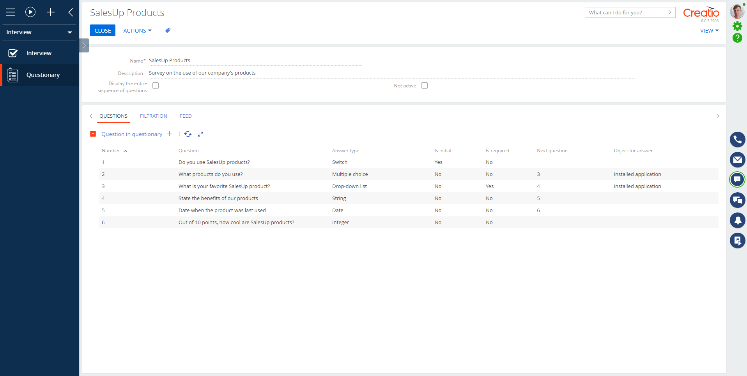
Questionnaire Management
When managing surveys goes easy

Slide 2

Questionnaire Management for Creatio
Questionnaire management for Creatio facilitates storing and managing information about surveys and questionnaires in Creatio.
Notes:
First of all, we normalize the client base and set up categorization and segmentation. The system allows you to use absolutely any information to categorize clients, from the size of the land bank to the number of goods purchased from us.
Also we calculate the potential of each client based on his land bank and grown
crops. Based on this information, we can prioritize the work of the manager and understand which customer have the maximum potential.
Also we maintaining information about competitor’s products to help the manager more carefully prepare for meetings with the client and consider with whom the client compares us.
and of course analytics. The system allows you to build analytics on any data that is in the system in any slices and views. this will allow you to analyze information in the most convenient form in a single system

Slide 3
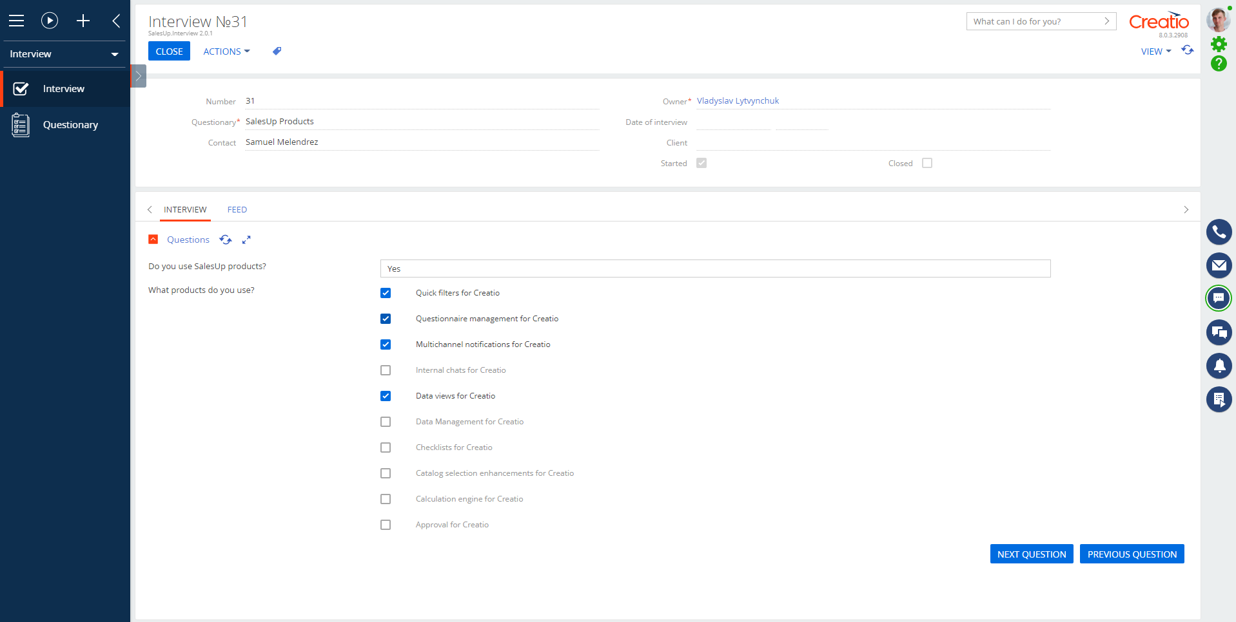
Questionnaire Management for Creatio
Use cases:
Online-stores to assess customer satisfaction level;
Field sales staff to conduct visits to retail outlets;
HR-department to carry out internal surveys.
Notes:
First of all, we normalize the client base and set up categorization and segmentation. The system allows you to use absolutely any information to categorize clients, from the size of the land bank to the number of goods purchased from us.
Also we calculate the potential of each client based on his land bank and grown
crops. Based on this information, we can prioritize the work of the manager and understand which customer have the maximum potential.
Also we maintaining information about competitor’s products to help the manager more carefully prepare for meetings with the client and consider with whom the client compares us.
and of course analytics. The system allows you to build analytics on any data that is in the system in any slices and views. this will allow you to analyze information in the most convenient form in a single system

Slide 4
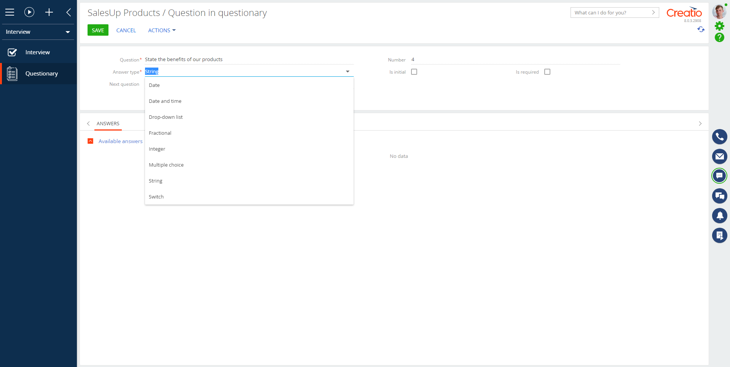
Questionnaire Management for Creatio
Key features:
Create polls using different options: single or multiple choice, open-ended questions;
Manage the question's order and record the time of interviews;
Customize the display of different questionnaires depending on the account, territory and qualifications of your employees;
Create double, blind and training visits to monitor and evaluate the performance of your employees;
Quickly collect analytics on the surveys carried out in Creatio.
Notes:
First of all, we normalize the client base and set up categorization and segmentation. The system allows you to use absolutely any information to categorize clients, from the size of the land bank to the number of goods purchased from us.
Also we calculate the potential of each client based on his land bank and grown
crops. Based on this information, we can prioritize the work of the manager and understand which customer have the maximum potential.
Also we maintaining information about competitor’s products to help the manager more carefully prepare for meetings with the client and consider with whom the client compares us.
and of course analytics. The system allows you to build analytics on any data that is in the system in any slices and views. this will allow you to analyze information in the most convenient form in a single system

Slide 5

Questionnaire Management for Creatio
CONTACT US:
salesup-it.com
care@salesup-it.com
Notes:
First of all, we normalize the client base and set up categorization and segmentation. The system allows you to use absolutely any information to categorize clients, from the size of the land bank to the number of goods purchased from us.
Also we calculate the potential of each client based on his land bank and grown
crops. Based on this information, we can prioritize the work of the manager and understand which customer have the maximum potential.
Also we maintaining information about competitor’s products to help the manager more carefully prepare for meetings with the client and consider with whom the client compares us.
and of course analytics. The system allows you to build analytics on any data that is in the system in any slices and views. this will allow you to analyze information in the most convenient form in a single system

