Slide 1

INNOV8 CENTRAL
for Creatio
User Manual — Walkthrough
Version 1.0 | July 2026

Slide 2
What we'll cover
1
Introduction
2
Getting Started
3
Application Flow
4
Using It — All Employees
5
Using It — Reviewers
6
Using It — Admins
7
FAQ
8
Glossary
Innov8 Central for Creatio

Slide 3
1 · Introduction
OVERVIEW
What Innov8 Central is, and who this guide is for
Innov8 Central is an innovation management solution built natively inside Creatio. It gives every employee a structured way to submit ideas, gives Reviewers a clear evaluation process, and gives leadership real-time visibility — all without leaving Creatio.
“Innovation for everyone” — any employee, in any department, at any level, can submit an idea and see it through to a decision.
Once installed, Innov8 Central appears as its own workspace with three areas:
Home Personal dashboard & org-wide metrics
Who this guide is for
Admins — setup & configuration
Reviewers — day-to-day workflow
All Employees — submit & track ideas
Ideas Full list of all submitted ideas
Settings Configuration (Admin-editable)
Innov8 Central — Introduction

Slide 4
2 · Getting Started
SETUP
Installing the app and assigning roles
1
2
3
Install
Assign roles
Review defaults
Search “Innov8 Central” on marketplace.creatio.com and install like any other Marketplace app.
→
Add reviewers to Innov8 Central Reviewers and configurators to Innov8 Central Admins. Everyone else is covered under All Employees automatically.
→
Check the four Settings tabs — the app works out of the box, so change values only if needed.
Innov8 Central — Getting Started

Slide 5
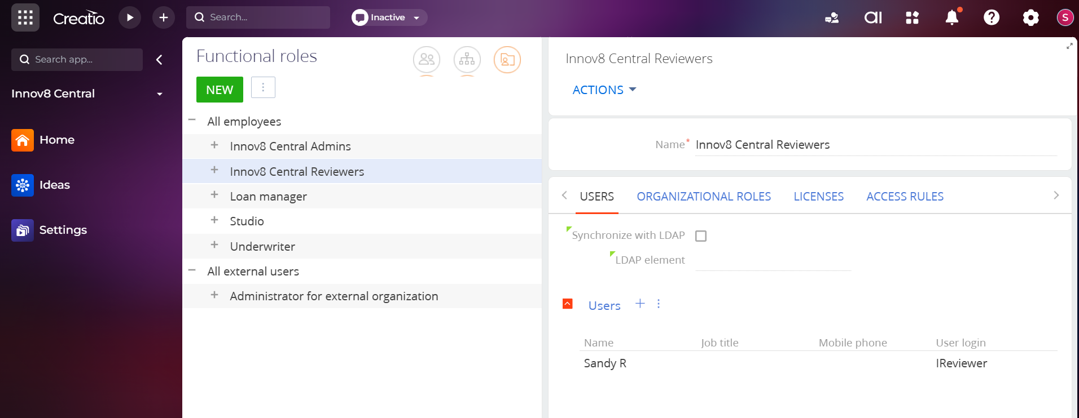
GETTING STARTED · 2.2
Assigning roles
Innov8 Central uses three roles. Every authenticated Creatio user automatically has All Employees capabilities.
The Admin's only role-related task is to assign specific users to Reviewers and Admins via Studio > Users > Functional Roles.
These two roles appear as child roles under All Employees — they add capabilities, they don't replace them.
Functional Roles screen — Reviewers and Admins nested under All Employees.

Slide 6
GETTING STARTED · 2.3–2.4
Idea Status & initial Settings
Every idea moves through a fixed sequence: Draft → Submitted → Under Review → Approved or Rejected. This is a Creatio lookup (LKPIdeaStatus) — informational only, not editable.
Business Goals
1
Add / edit / delete. 9 defaults provided.
Points Category
2
Edit point values only (Author: 1,000 / Co-author: 500).
Feasibility Score
3
Add / edit / delete. 5-point scale by default.
Expected Impact Score
4
Add / edit / delete. 5-point scale by default.
Innov8 Central — Getting Started

Slide 7
3 · Application Flow
HOW IT WORKS
From idea to decision — every time
Draft
→
Submitted
→
Under Review
→
Approved / Rejected
Author drafts the idea
Visible org-wide
Reviewer evaluates
Points awarded / final
The Author can keep iterating on idea details — title, summary, co-authors, business goals, and narrative fields — based on feedback, right up until a final decision is made.
Innov8 Central — Application Flow

Slide 8
3.1 · Roles at a glance
APPLICATION FLOW
Who can do what
All Employees
Reviewers
Admins
Submit ideas
View & search all ideas
Comment via the Feed
Track own ideas, points & reviews
Everything All Employees can do, plus:
Assign self/others as Reviewer
Move to Under Review
Score & approve/reject
Archive ideas
Everything All Employees can do, plus:
Configure Business Goals & scoring
Edit Points Category values
Use Import on Ideas List
Archive ideas
Innov8 Central — Application Flow

Slide 9
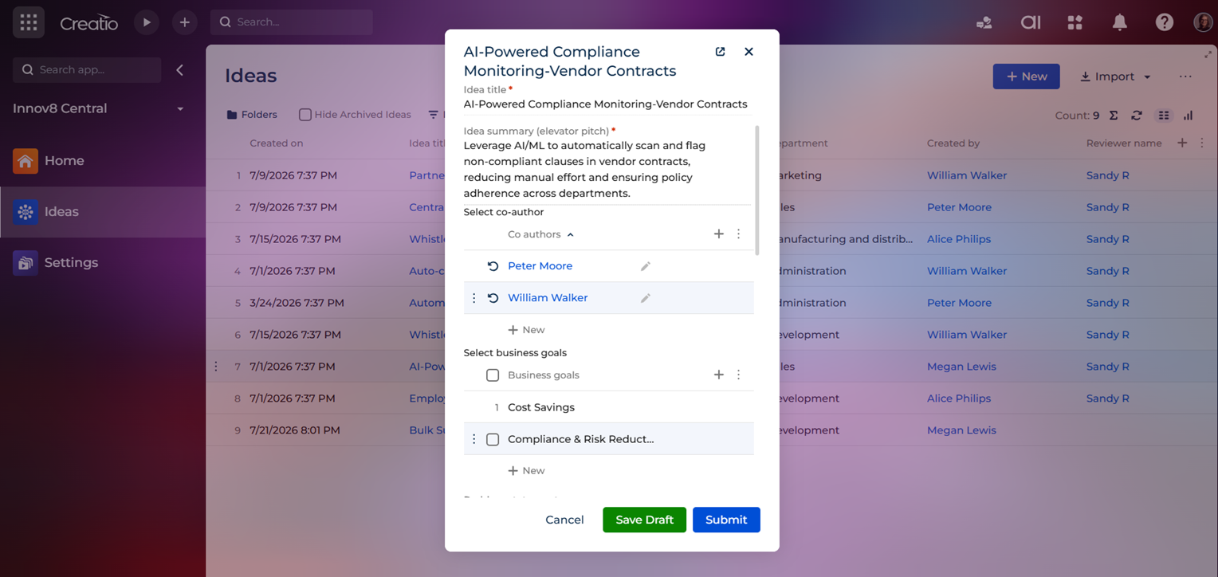
ALL EMPLOYEES · 4.1
Submitting a new idea
Click + New on the Ideas List to open the submission form.
Only Idea title and Idea summary are required to Save Draft — everything else can be filled in later.
Click Submit when it's ready to be seen by everyone and picked up for review.
The New record idea submission form.

Slide 10
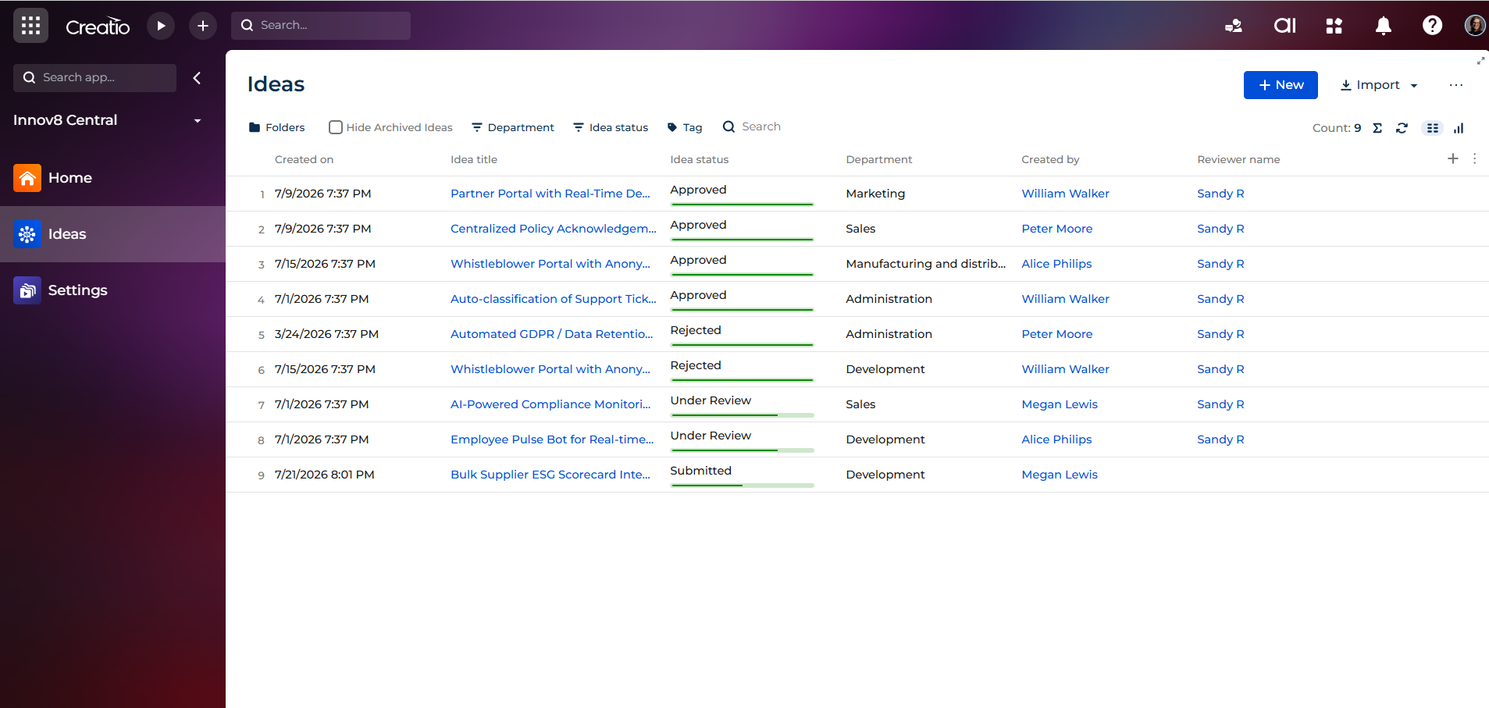
ALL EMPLOYEES · 4.2
Viewing the Ideas List
Shows every idea that isn't in Draft status. Drafts stay private to their Author.
Filter by Department, Idea status, or Tag; search by keyword; organise with Folders.
The Reviewer name column shows who's reviewing each idea, right in the list.
The Ideas List page.

Slide 11
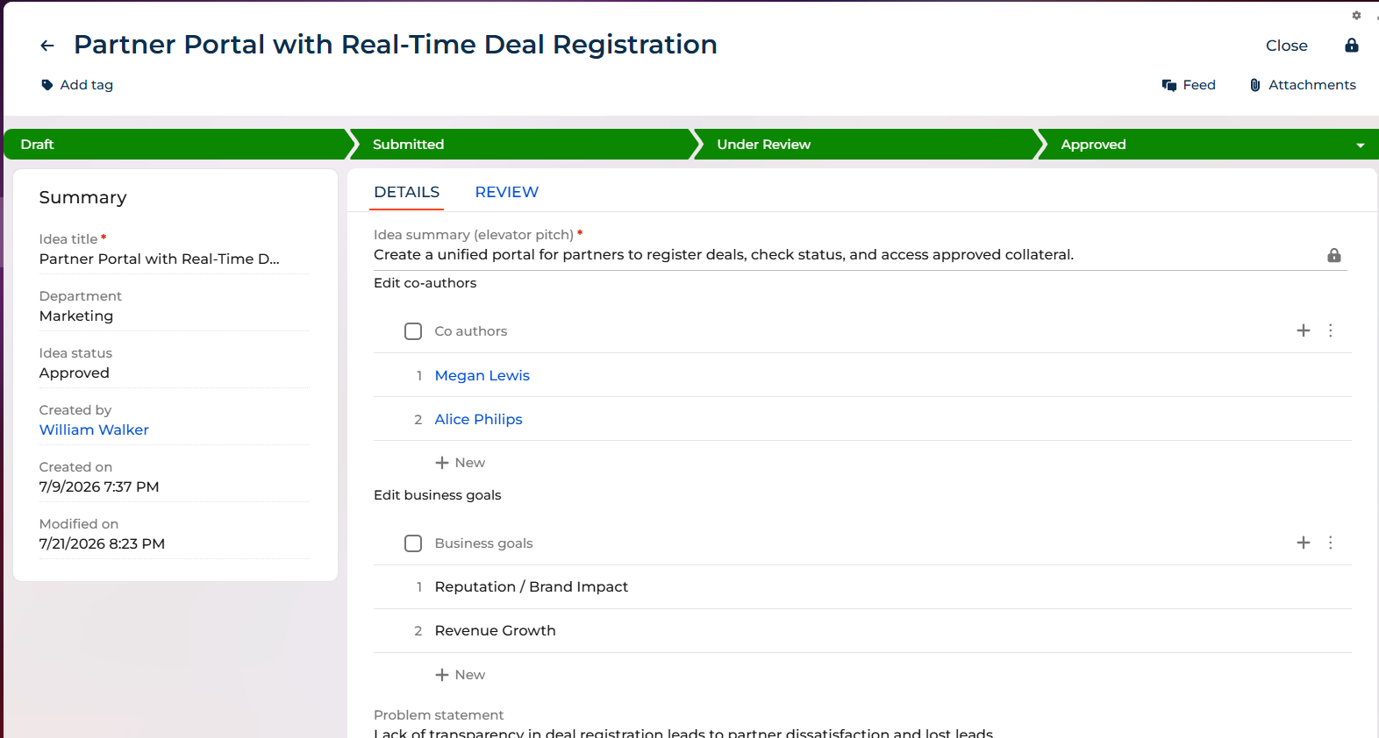
ALL EMPLOYEES · 4.3
Viewing & editing an idea
The header shows the idea's stage: Draft → Submitted → Under Review → Approved / Rejected.
Only the original Author can edit the Details tab. Everyone else sees these fields read-only.
Created by, Created on, Modified on, and Idea status are always read-only.
Idea Detail page, Details tab.

Slide 12
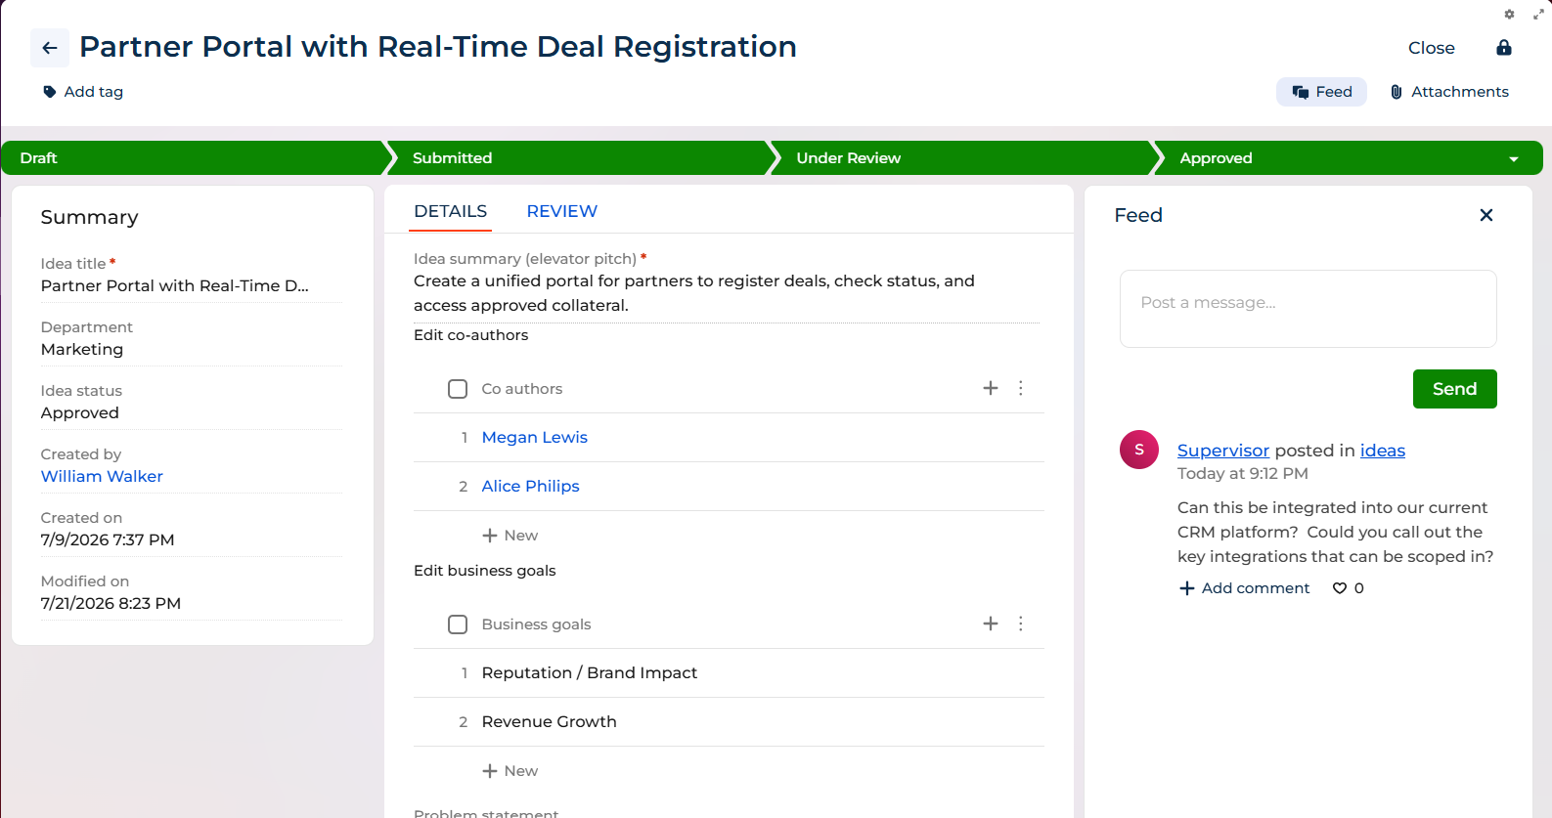
ALL EMPLOYEES · 4.4
Collaborating via the Feed
Any employee — not just the Author or Co-authors — can post questions or feedback through the Feed.
The Author can reply, and the whole conversation stays visible to the entire organisation.
Attachments are managed separately, and both Author and Reviewer can add files.
The Feed panel open alongside an idea's details.

Slide 13
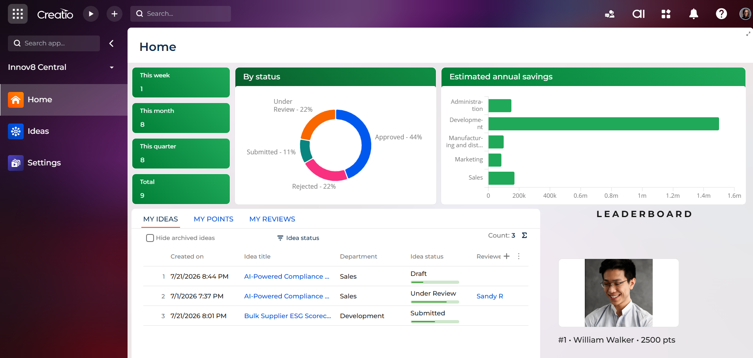
ALL EMPLOYEES · 4.5
Your Home Page
Your personal dashboard, plus org-wide metrics: submission counts, status breakdown, and estimated savings by department.
Three personal tabs: My Ideas, My Points, and My Reviews (populates only for Reviewers).
The Leaderboard updates in real time as points are awarded.
The Home Page dashboard.

Slide 14
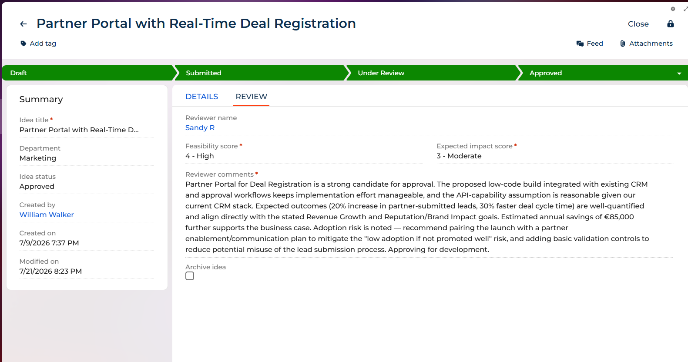
REVIEWERS · 5.2
Reviewing an idea
Open any Submitted idea's Review tab — visible to everyone, editable only by Reviewers.
Reviewer name is mandatory once you move to Under Review.
Feasibility score, Expected Impact Score, and Reviewer comments become mandatory before Approving or Rejecting.
The Review tab — scoring and reviewer comments.

Slide 15
5.2.1 · Step by step
REVIEWERS
The Reviewer's workflow, start to finish
1
Open a Submitted idea and go to the Review tab.
2
Set Reviewer name to yourself (or another Reviewer) and move to Under Review.
3
Evaluate the idea — complete Feasibility score, Expected Impact Score, and Reviewer comments.
4
Set the status to Approved or Rejected via the dropdown at the end of the stage pipeline.
5
If Approved: points are auto-allocated and the Leaderboard updates immediately.
6
If Rejected: no points allocated — this is final, with no resubmission flow.
Innov8 Central — Reviewers

Slide 16
5.3 – 5.4 · Archiving & Collaboration
REVIEWERS
Wrapping up a review
3
Archiving ideas
4
Collaborating during review
Once an idea reaches Approved or Rejected, Reviewers (and Admins) can check Archive idea checkbox. Archived ideas are hidden by default but can still be found via Hide Archived Ideas filter.
Use the Feed to ask the Author clarifying questions any time before a final decision. The Author can respond, and the exchange stays visible to everyone — keeping the process transparent.
Innov8 Central — Reviewers

Slide 17
6.1 · What Admins can configure
ADMINS
Settings-level control, by tab
Settings tab
Admin can
Admin cannot
Business Goals
Add, edit, delete (if unused)
Delete a goal already used on an idea
Points Category
Edit point values
Add, rename, or delete categories
Feasibility Score
Add, edit, delete (if unused)
Delete a value already used on an idea
Expected Impact Score
Add, edit, delete (if unused)
Delete a value already used on an idea
Innov8 Central — Admins

Slide 18
6.2 – 6.3 · Beyond Settings
ADMINS
Other capabilities, and what not to touch
Other Admin-only capabilities
What to know but not touch
Import: bulk-import ideas from the Ideas List (Admin-only).
Archive idea: available once an idea is Approved or Rejected, same as Reviewers.
The Idea Status lookup (LKPIdeaStatus) — fixed by design.
The Reviewers / Admins functional roles — set up once in Creatio Studio
Innov8 Central — Admins

Slide 19
7 · Frequently Asked Questions
FAQ
Can a rejected idea be resubmitted?
Can ideas be deleted?
No. Rejected is final — changes must happen before a decision is made.
No, by design — for full transparency and auditability.
Are there notifications?
Can Co-authors edit an idea?
Not currently — no automated email or in-app alerts yet.
No — only the Author can edit the Details tab.
Do point changes affect past approvals?
Does savings convert currencies?
No — changes apply only to future approvals.
No — it sums raw values regardless of currency selected.
How often does the Leaderboard update?
Can Co-authors edit an idea?
In real time, immediately after each approval.
No — only the Author can edit the Details tab.
Innov8 Central — FAQ

