Slide 1
SalesUp Multichannel Bulk Messaging for Creatio
Maximize outreach, minimize effort

Slide 2
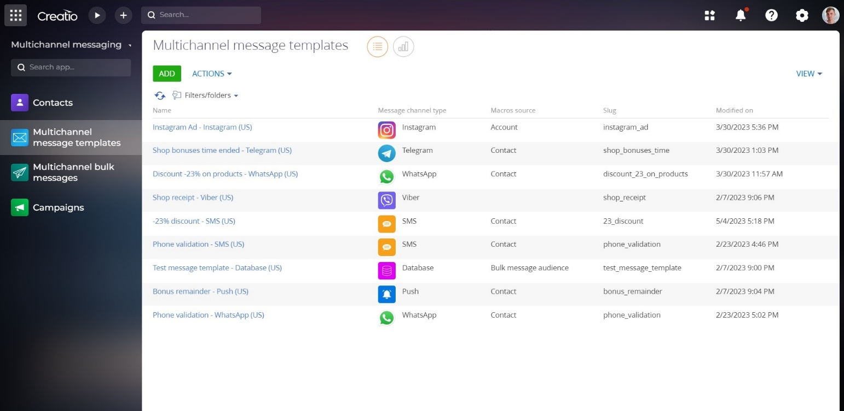
SalesUp Multichannel Bulk Messaging for Creatio is a versatile product that allows you to stay connected with your clients and is designed for sending one-time bulk messages via various communication channels, such as:
SMS;
Mobile apps;
Social media;
Messengers.

Slide 3
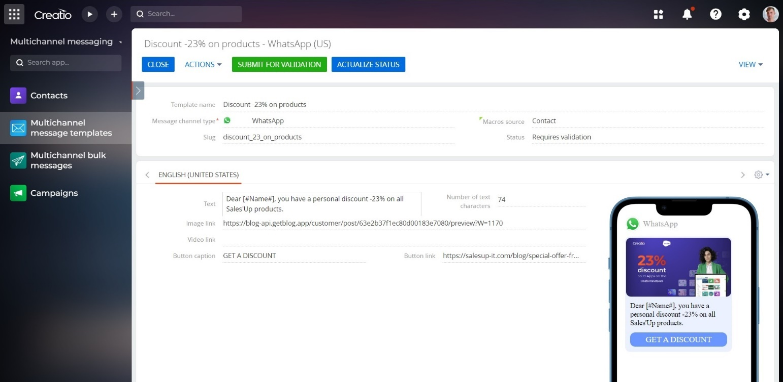
Use cases:
Utilize this product to efficiently set up and launch bulk messaging and triggered messages containing news, discounts, special offers, birthday greetings, and more.

Slide 4
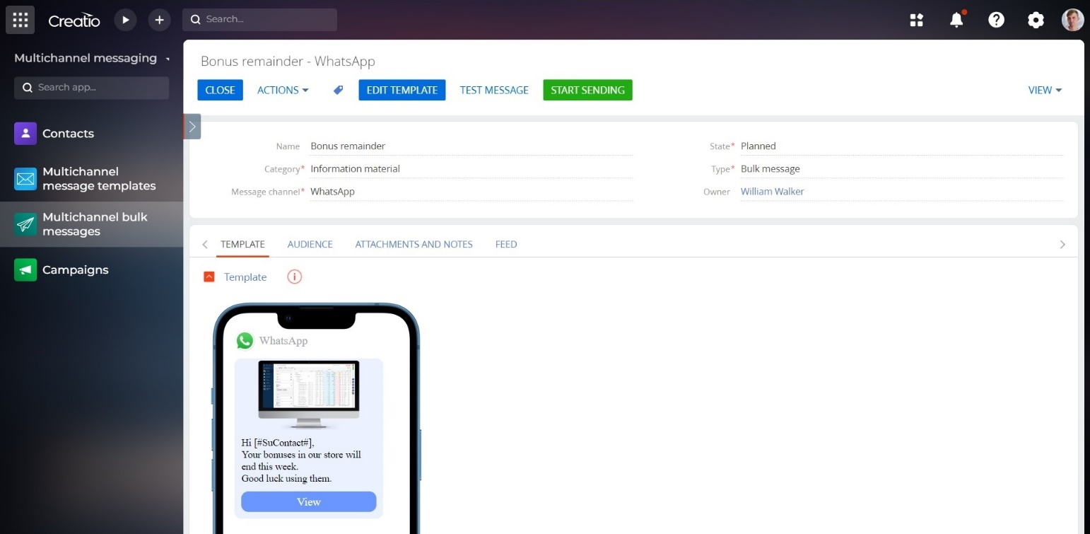
Key features:
Real-time monitoring of bulk messaging progress, including the number of sent and received messages, as well as individual message status and results;
Manually initiate bulk messaging at any time;

Slide 5
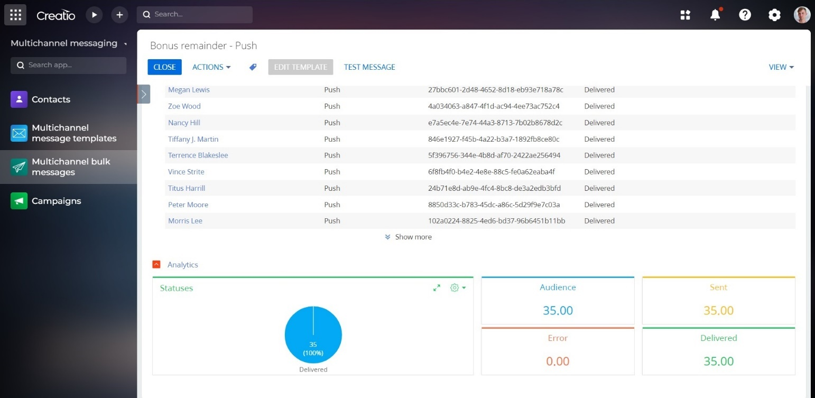
Key features:
Easy-to-use setup wizard for bulk messaging;
One-time sending of messages across multiple communication channels, including SMS, push-notifications, mobile apps, social media and messengers;
Comprehensive analytics on bulk messaging performance;

Slide 6
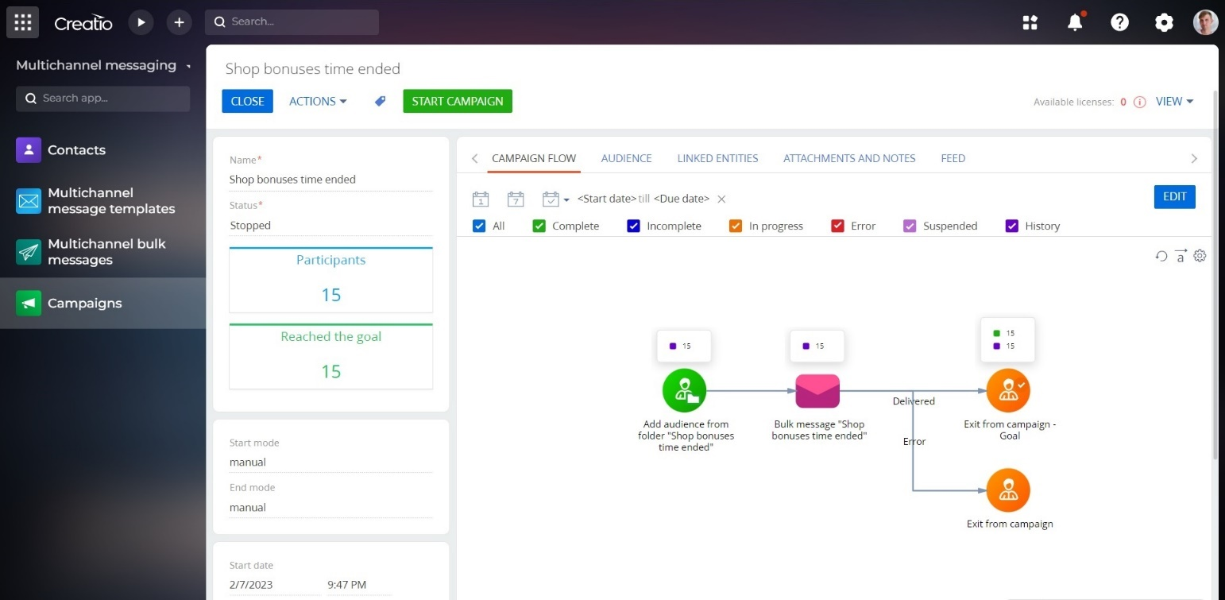
Key features:
Preview customized message templates to ensure proper formatting and appearance;
Target specific contacts or dynamic groups for message delivery;
Flexible settings for automated sending of triggered messages.

Slide 7
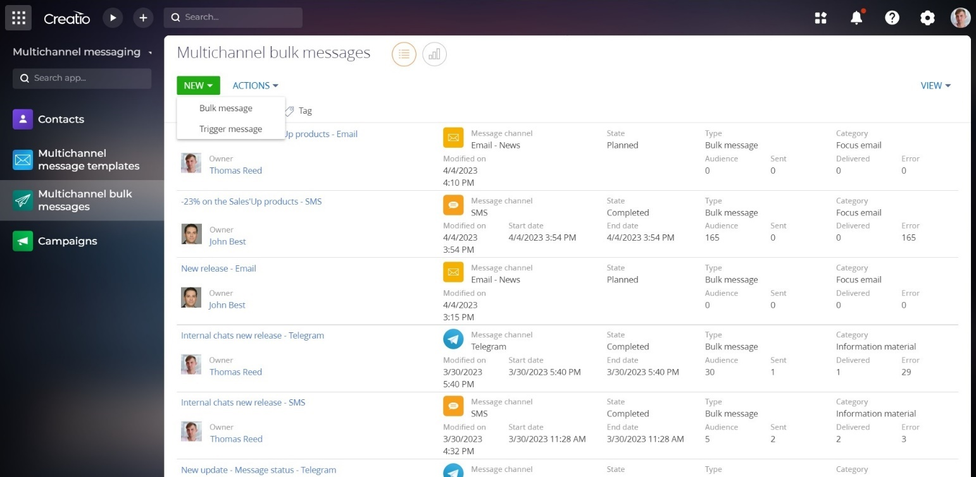
Notes:
To send messages via SMS, Push, and WhatsApp, you must have a separate account with Infobip (or another messaging provider). Sending messages through these channels may unconditional fees from the provider.

Slide 8
Notes:
Sending messages by phone number is not possible for Facebook, Telegram, Instagram communication channels.
To use Telegram, Facebook, and Instagram communication channels, users must first write to the chatbot or messenger page to receive a unique id.

Slide 9
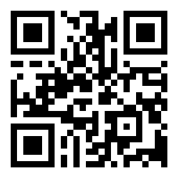
THANK YOU!
CONTACT US:
salesup-it.com
care@salesup-it.com

